Slide 1

Bless You!

Slide 2
Background
Early indications of events in the society.
One such event is the outbreak of an influenza.
Sneeze detectors can early detect such an outbreak.
2015-03-19
DVA406 presentation - Bless You! v. 1.0/0

Slide 3
Use Case
A microphone listens to the sound in a public place.
When it detects that someone sneezes a counter is incremented.
A supervisory system reads the sneeze count at cyclic intervals.
The read counter values can be used to detect if a flu is in progress.
2015-03-19
DVA406 presentation - Bless You! v. 1.0/0

Slide 4
Our Program
Limitations
  No continous evaluation
  Uses sound samples
  Console interface
2015-03-19
DVA406 presentation - Bless You! v. 1.0/0

Slide 5
System Overview
Command Line Program
  Batch mode
  Interactive mode
About 160 sound samples
  100 sneezes
  60 none-sneezes
Text report:
  Proposed sound type
  Statistics
.wav files
Extract Features
.ftr files
Sound file to be evaluated
.ftr for evaluated file
CBR System
Result report
Operator Interaction
2015-03-19
DVA406 presentation - Bless You! v. 1.0/0

Slide 6
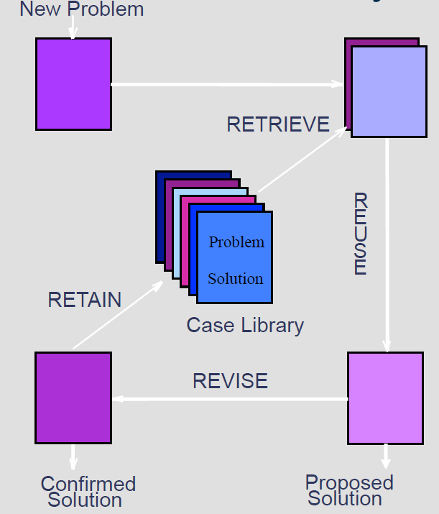
Classic CBR Overview
New Problem: sound sample
Case Library:
  Confirmed sneeses (50)
  Confirmed none-sneezes (50)
Proposed Solution:
  Proposed Sneeze
  Proposed None-Sneeze
2015-03-19
DVA406 presentation - Bless You! v. 1.0/0

Slide 7
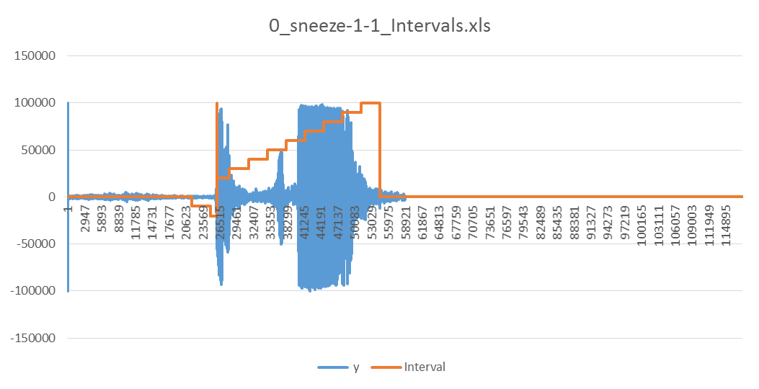
Extract Features from Sound Sample
.wav-files PCM, 44.1 kHz, 16 bits, 1 or 2 channels (mono/stereo)
Stereo -> Mono
Normalize to 100000
Analyse
  Trigger On
  Trigger Off
  Split into intervals
2015-03-19
DVA406 presentation - Bless You! v. 1.0/0

Slide 8



Feature types per Interval
  Peak values
  Average values
  RMS values (effect)
  Peak to peak values
  CF - Crest Factor values
  PZ - Passage through Zero values
  FFT values (Fast Fourier Transform)
    Sample length 2¹²
    Sample length 2¹⁴
    Sample length 2¹⁶
  Feature values normalized within intervals (0.0 … 1.0)
2015-03-19
DVA406 presentation - Bless You! v. 1.0/0

Slide 9
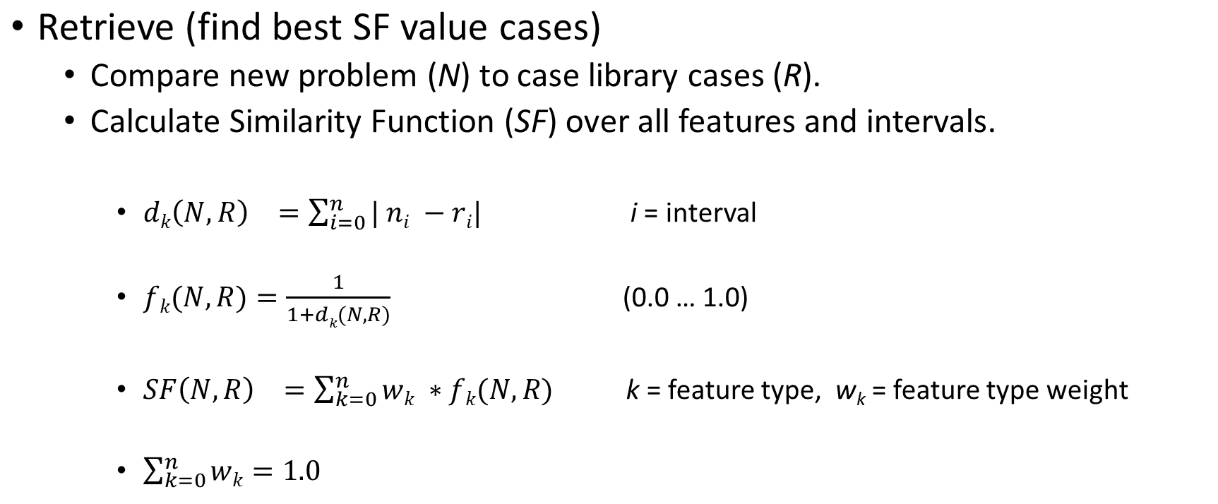
CBR System
2015-03-19
DVA406 presentation - Bless You! v. 1.0/0

Slide 10
CBR System
Reuse (generate proposed solution)
  Pick 5 best cases, highest Similarity Function
  Use majority vote to decide if proposed sneeze/none-sneeze
2015-03-19
DVA406 presentation - Bless You! v. 1.0/0

Slide 11
CBR System - Maintenance
Revise
  Add a new known case => 101 cases in library
  Iterate each of 101 cases in case library while calculating SF.
    Obtain worst case
      Prio 1: case that have participated in voting and voted wrong every time
      Prio 2: case that never participated in voting and has lowest SF value
      Prio 3: case that has the lowest SF value
Retain
  Retain the best cases while preserving sneeze/none-sneeze ratio, i.e. remove the worst => back to 100 cases in library.
2015-03-19
DVA406 presentation - Bless You! v. 1.0/0

Slide 12
Build Environment
Visual Studio
C#
2015-03-19
DVA406 presentation - Bless You! v. 1.0/0

Slide 13

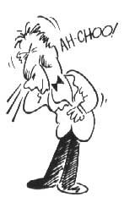
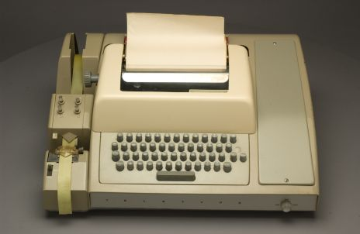
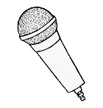
Demonstration
Ta-da!
Sneeze detected!
2015-03-19
DVA406 presentation - Bless You! v. 1.0/0

Slide 14
What we learned
Github (Conflicts!)
Sound file structure
FFT (Fast Fourier transform)
CBR Systems
    Distance calculation
    Similary functions
2015-03-19
DVA406 presentation - Bless You! v. 1.0/0

Slide 15
The End
Thanks for listening!
2015-03-19
DVA406 presentation - Bless You! v. 1.0/0

